Slide 1
NODE-GAM: NEURAL GENERALIZED ADDITIVE MODEL FOR INTERPRETABLE DEEP LEARNING
July 21, 2022
Gwangwoo Kim

Slide 2
Contents
Introduction
Background
Model design
Results

Slide 3
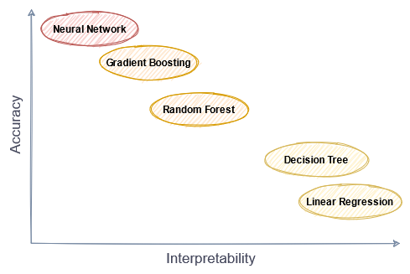
Introduction

Slide 4
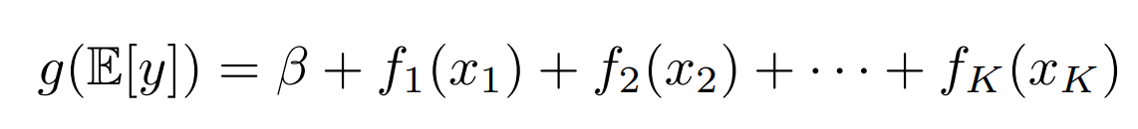
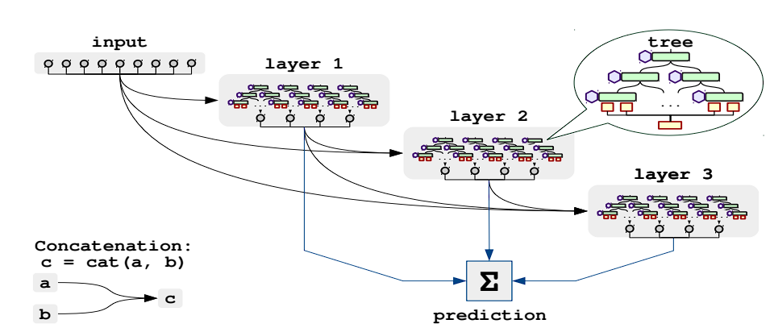
Introduction
Generalized Additive Models (GAMs)
or Neural Additive Models
 | NAMs | NODE
Pros | Interpretability, differentiability | SOTA differentiability
Cons | scalability | Interpretability,
Neural Oblivious Decision Ensembles (NODE)

Slide 5
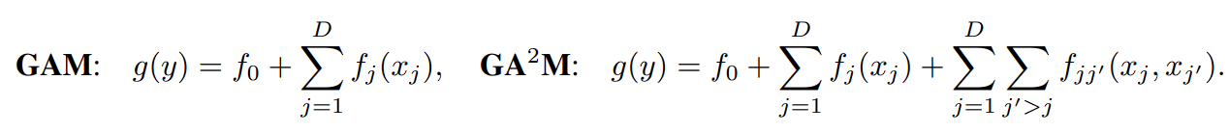
2. Background
Explainable Boosting Machine (EBM) is a tree-based, cyclic gradient boosting Generalized Additive Model with automatic interaction detection.

Slide 6
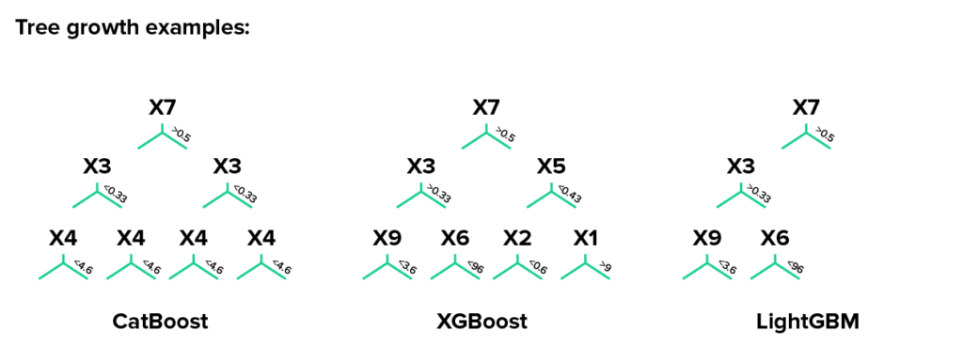
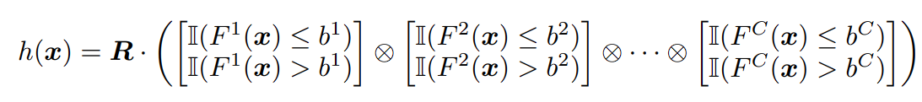
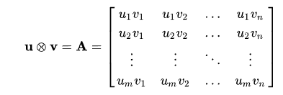
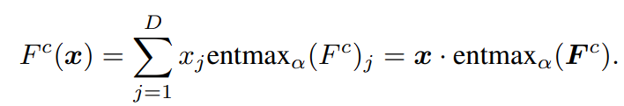
2. Background
An Oblivious Decision Trees (ODT) is a traditional decision tree except for all nodes in the same depth share the same input features and thresholds. It is not differentiable, but note that the output of the tree can be rewritten as
Recall:
Note also that the indicator function and the feature selection function are not differentiable, so if we replace
them with differentiable functions that are parametrized, then the ODT is differentiable, Popov et al. (2019)

Slide 7
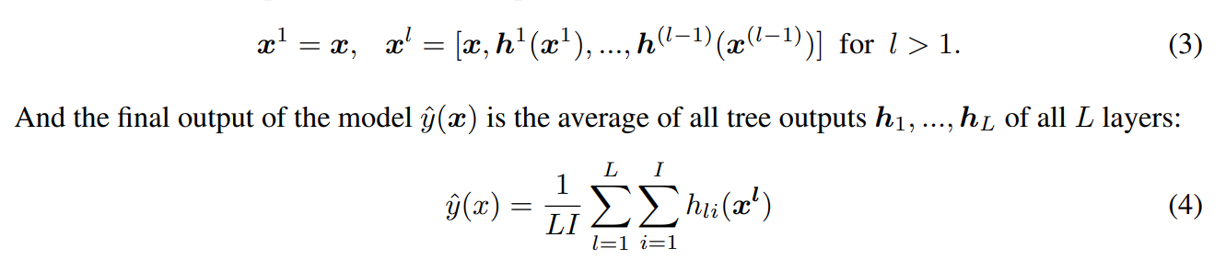
2. Background

Slide 8



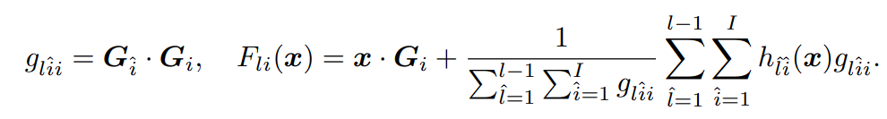
3. Model design
Introduce a temperature annealing parameter T.
Make the logits the same across depth, i.e.,
Avoid the connections between trees that focus on different features.

Slide 9
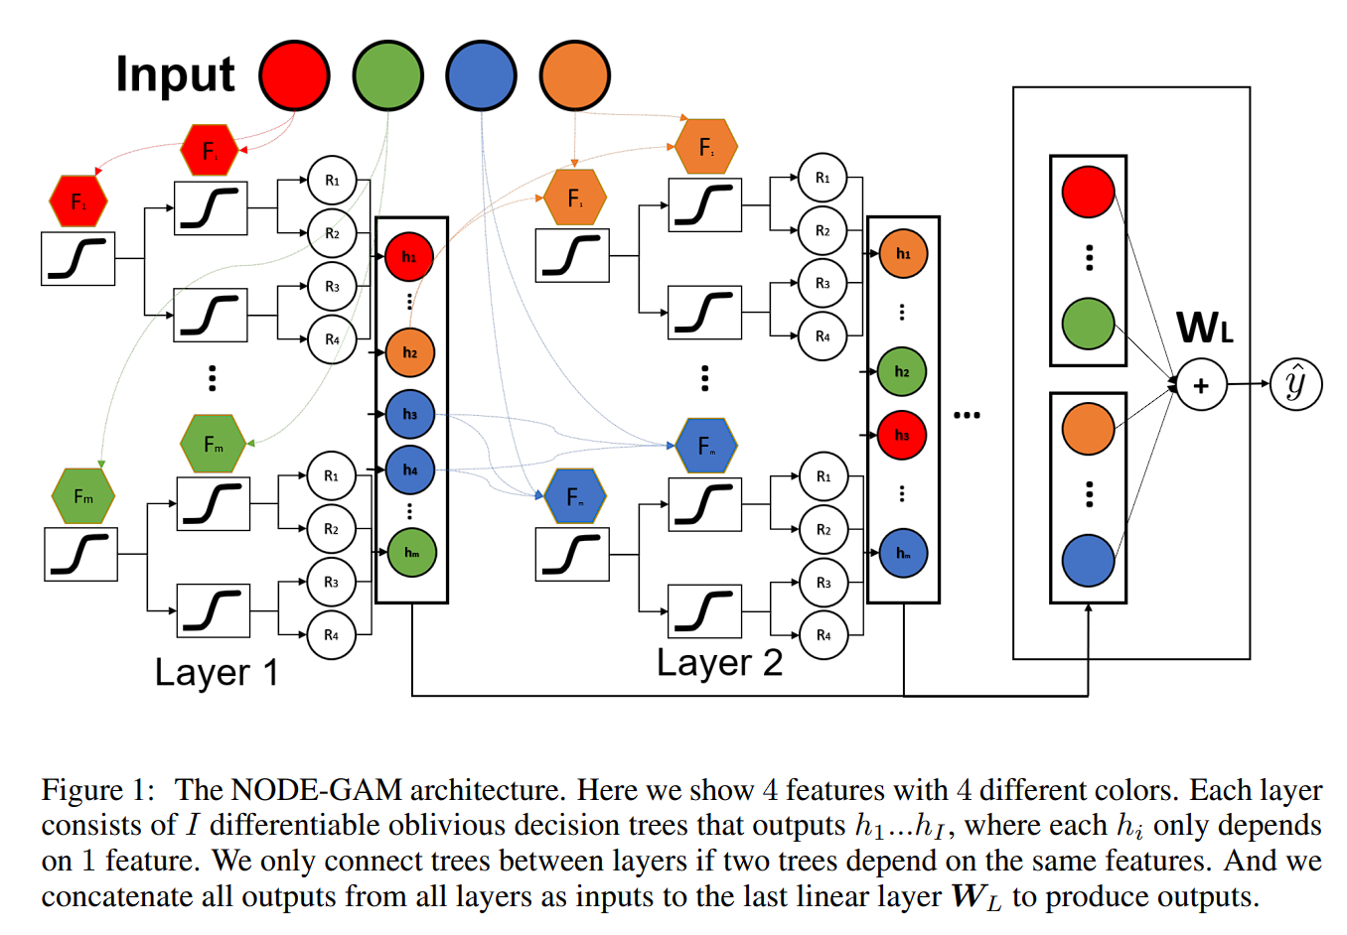
3. Model design

Slide 10
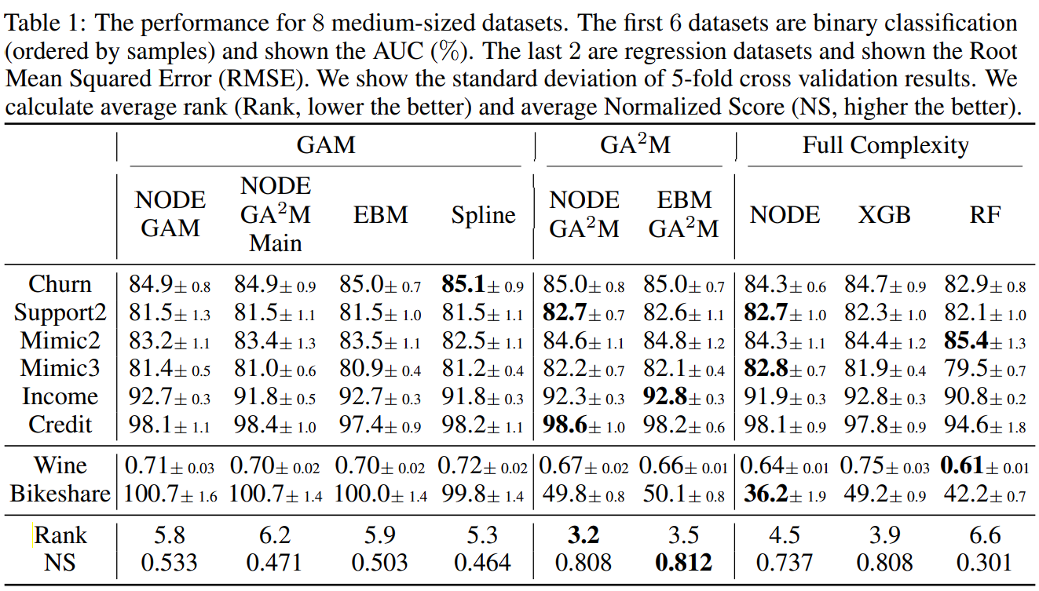
4. Results

Slide 11
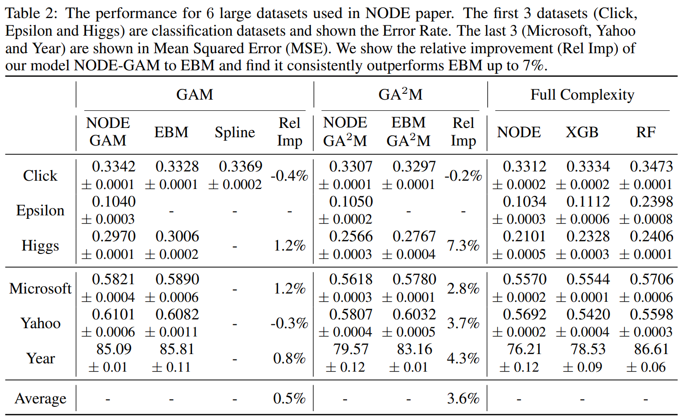
4. Results

Slide 12
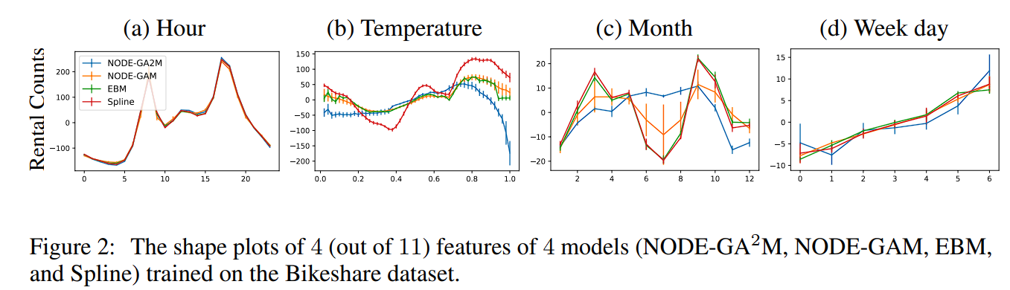
4. Results
Here temperature is normalized between 0 and 1, where 0 means -8°C and 1 means 39°C.
Since it’s quite unlikely people rent more bikes when it’s getting colder especially below 0°C, the pattern shown by GA2M seems more plausible.

Slide 13
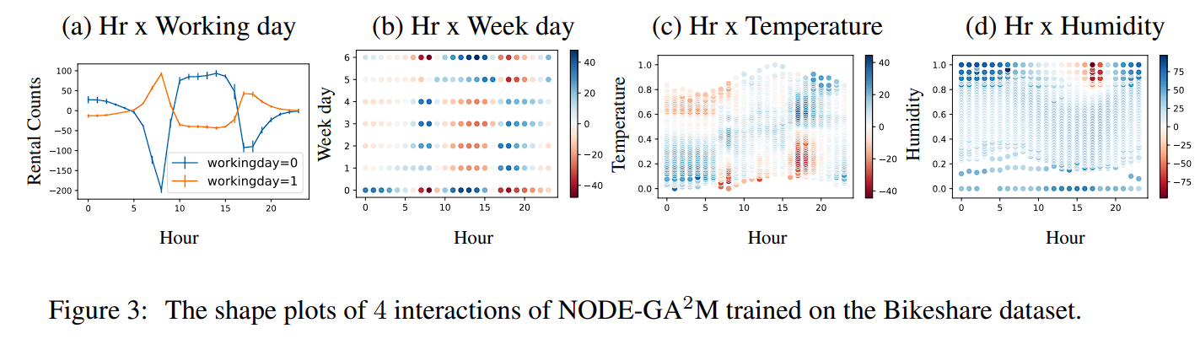
4. Results
Overall these interpretable graphs enable us to know how the model predicts and find interesting patterns.

Slide 14
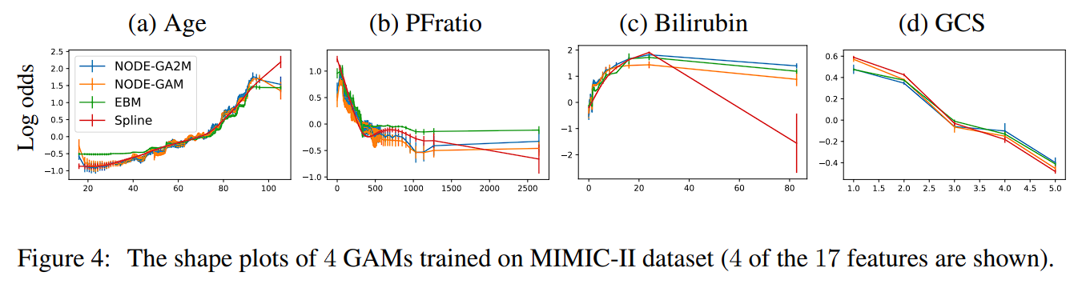
4. Results
PFratio: a measure of how well patients oxygenate the blood.
Bilirubin is a yellowish pigment made during the normal breakdown of red blood cells.
Glasgow Coma Scale (GCS): a bedside measurement for how conscious the patient is with 1 in a coma and 5 as conscious.

Slide 15
4. Results
We see NODE-GAM/GA2M shows risk increases a bit when age < 20.
NODE-GAM/GA2M and EBM capture a sharp drop at 332.
High bilirubin(>2) indicates liver or bile duct problems.

Slide 16
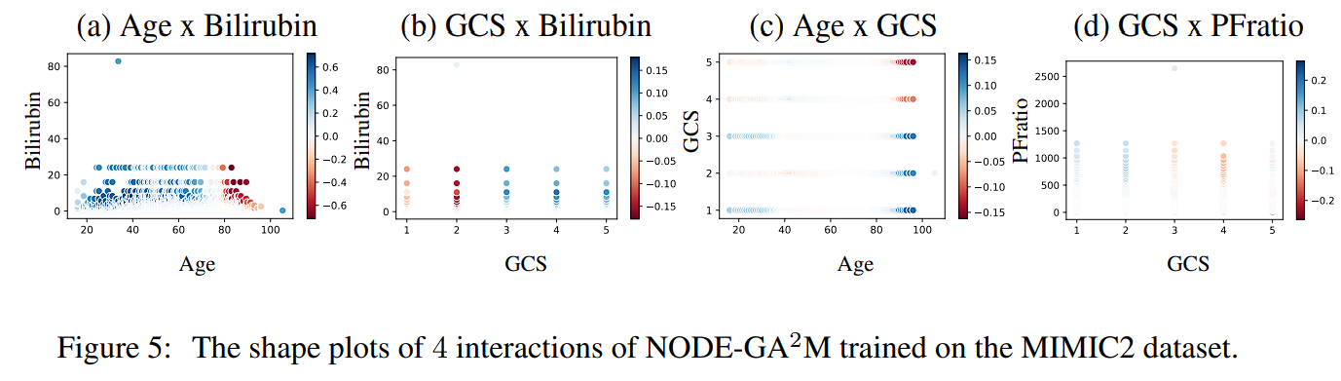
4. Results

Slide 17
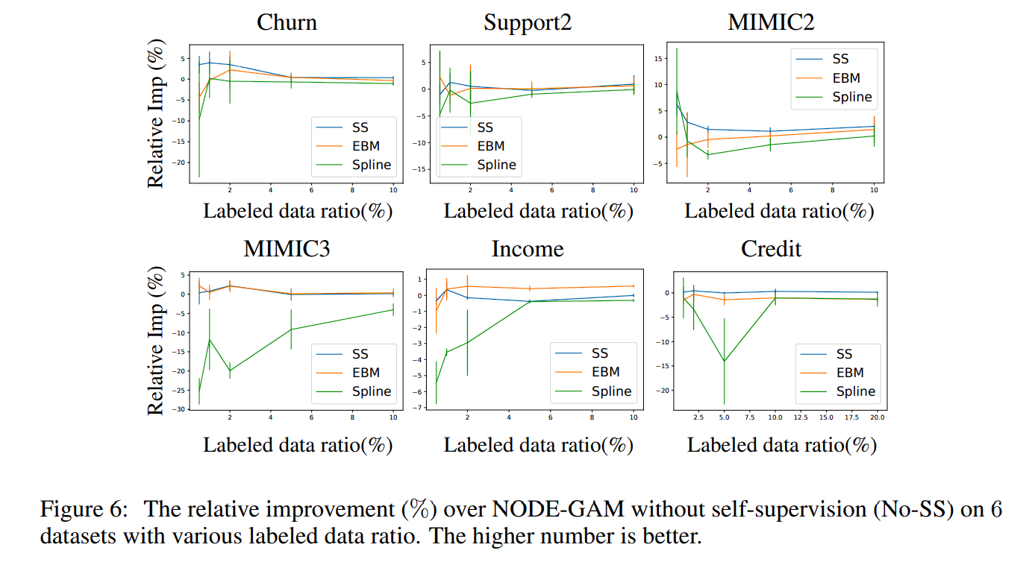
4. Results

